Slide 1
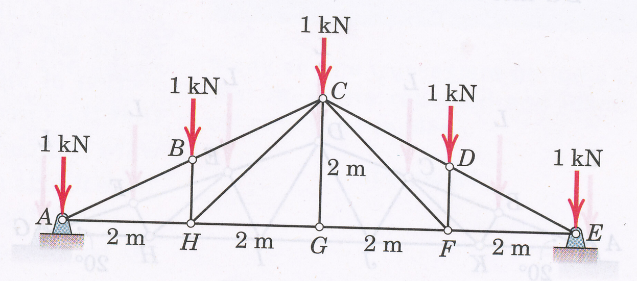
ES2501: Introduction to Static Systems
Quiz #5
Name:__________
A snow load transfers the forces, as shown to the upper joints of a Pratt roof truss. Neglect any horizontal reactions at the supports (or you may assume one of the supports, say, say the support at E is a roller-support). Solve for the internal forces in all members and indicate whether the members are in tension or compression.
Either joint analysis or section analysis can be used. Your solution should include necessary free-body diagrams and static equilibrium equations. Please circle your answers and also mark your results on the figure.

